Slide 1
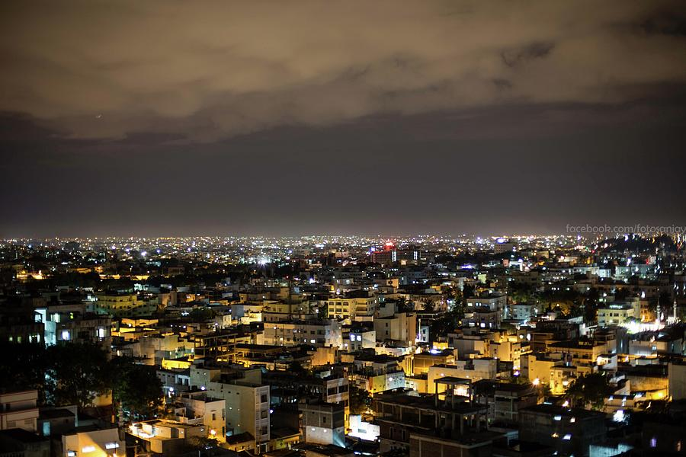

Seismic Safety of Built Environment
Earthquake Engineering Research Centre

Slide 2
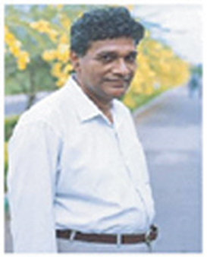
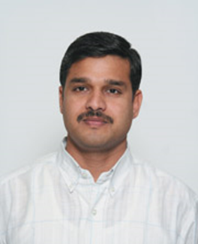
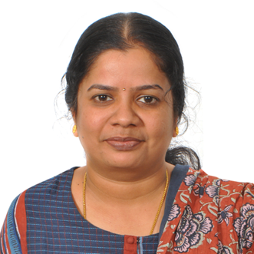
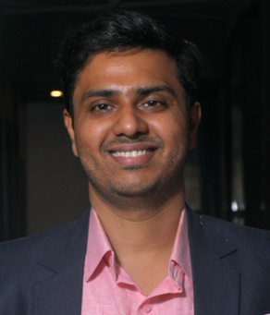
EERC
Faculty Members
  M. Venkateshwarlu
  Ramancharla Pradeepkumar
  Sunitha Palissery
  Pravin Kumar Venkat Rao

Slide 3
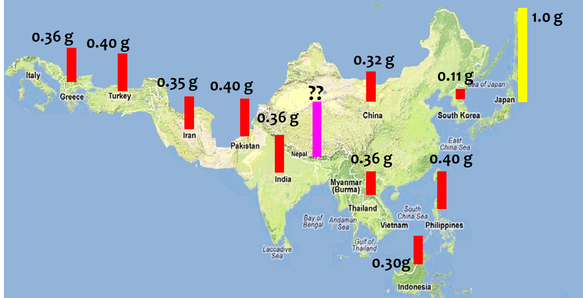
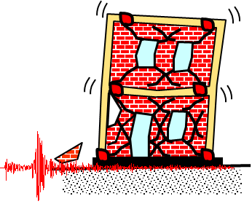
Research Focus
Estimation
  Seismic Hazard
  Seismic Vulnerability
  Seismic Risk
  Seismic Design
Simulation
  Failure Mechanisms
  Damage Modes

Slide 4
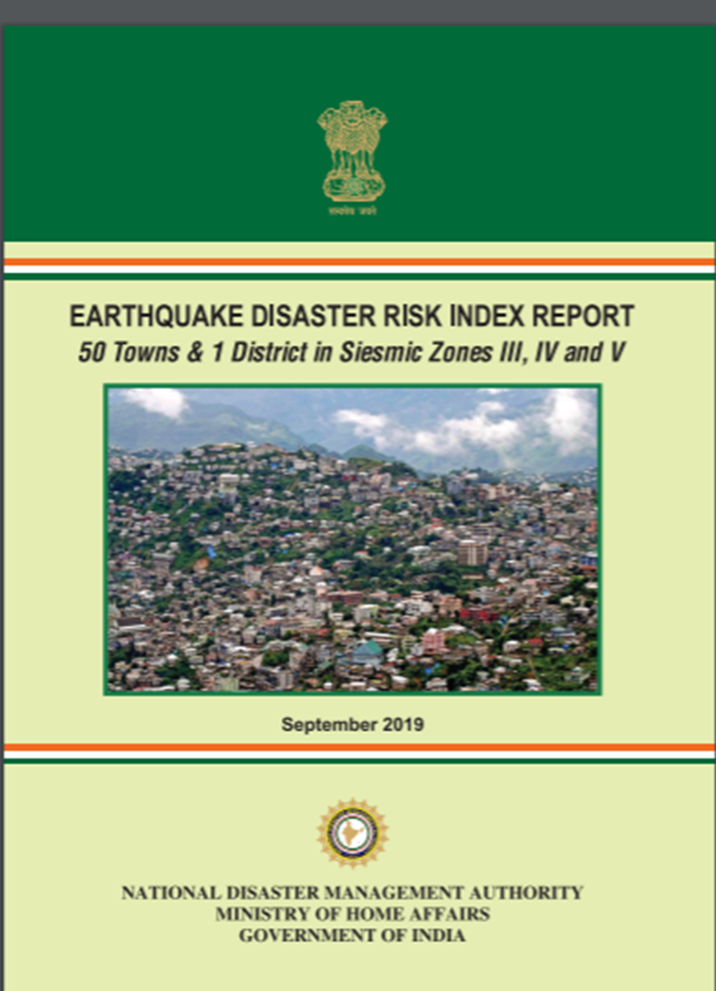
Research Focus
Mitigation
  Awareness & Preparedness
  Earthquake Disaster Risk Index
  Prediction
    Computation
    Visualisation

Slide 5
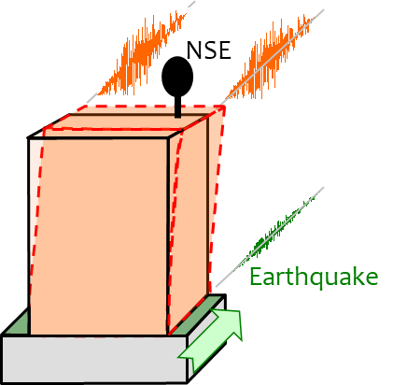
Research Summary
New Buildings & Existing Buildings
  Lifeline Buildings
    Building Contents
Disaster Management

Slide 6
Discuss?
eerc@iiit.ac.in
B2-108, Vindhya
  sunitha.palissery@iiit.ac.in

